Slide 1
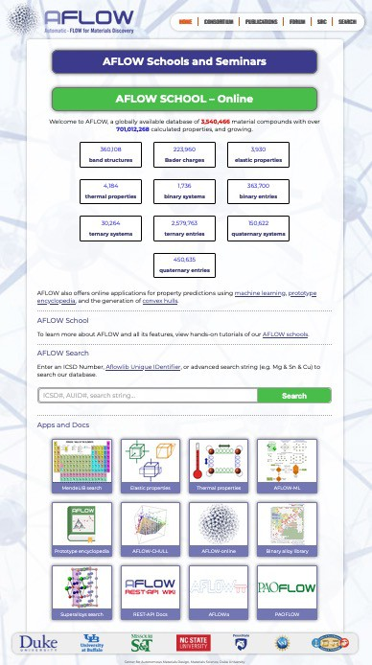
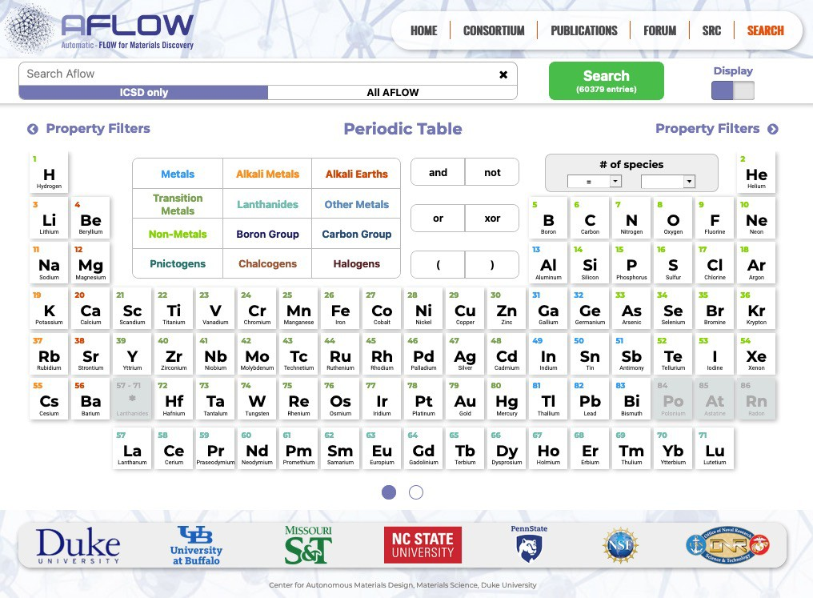




AFLOW: Integrated infrastructure for computational materials discovery
COREY OSES DAVID HICKS MARCO ESTERS RICO FRIEDRICH
ANDRIY SMOLYANYUK CORMAC TOHER
STEFANO CURTAROLO
Materials Science Duke University

Slide 2
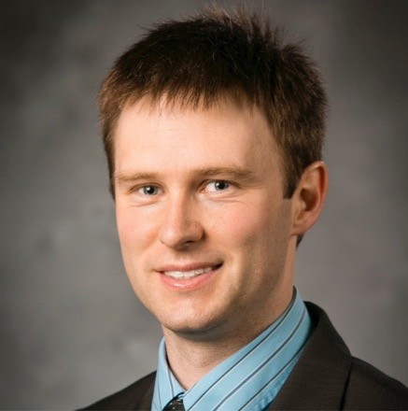
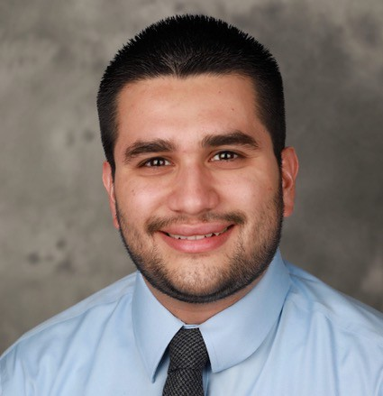
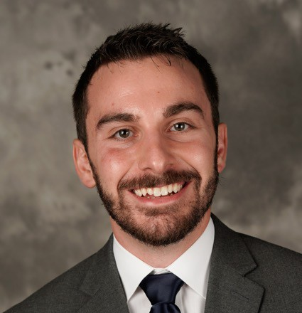

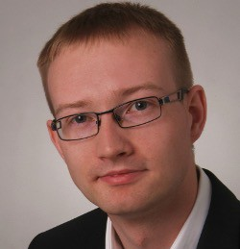
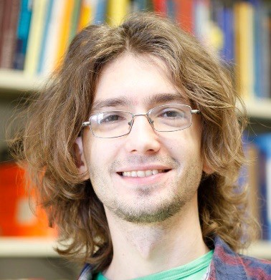
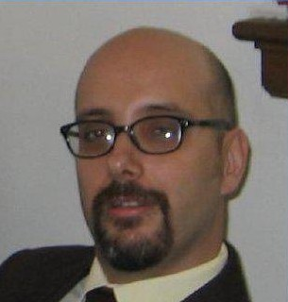
AFLOW School Team
Cormac Toher
Corey Oses
David Hicks
Marco Esters
Rico Friedrich
Andriy Smolyanyuk
Stefano Curtarolo

Slide 3
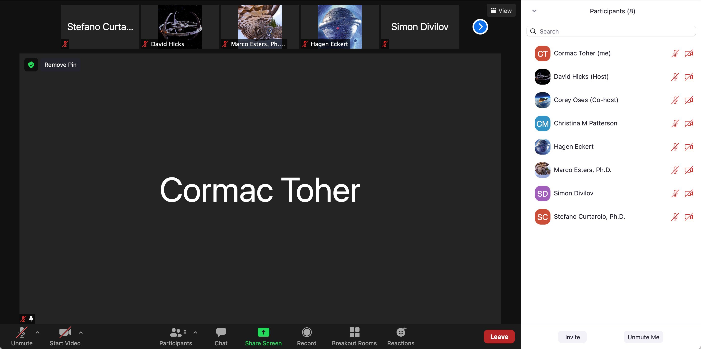
AFLOW School Zoom Logistics
If you have a question, use the Chat or Raise Hand functions
Microphone should be muted if not speaking

Slide 4
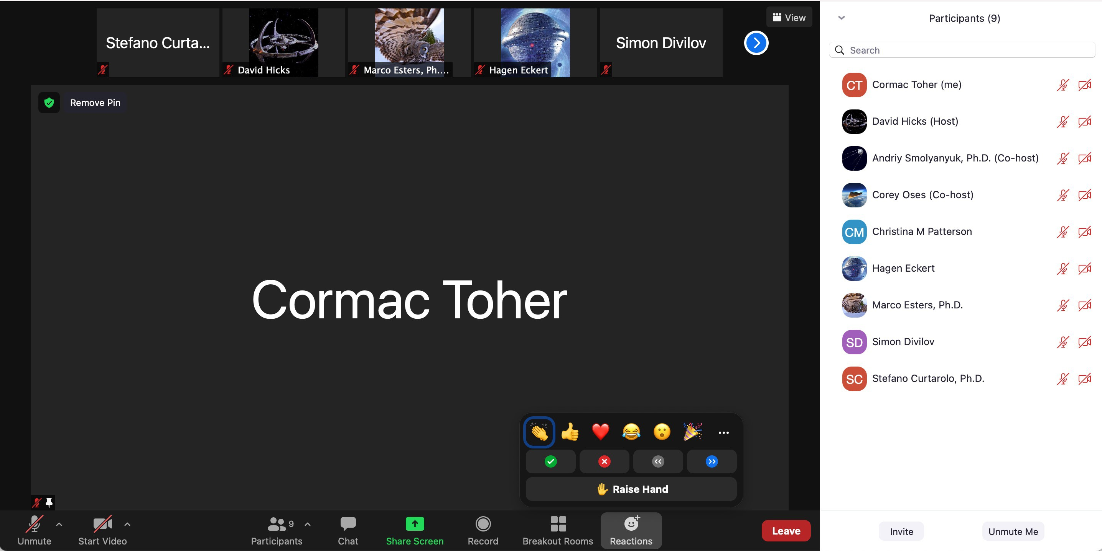
AFLOW School Zoom Logistics
Raise hand button
Reactions button

Slide 5
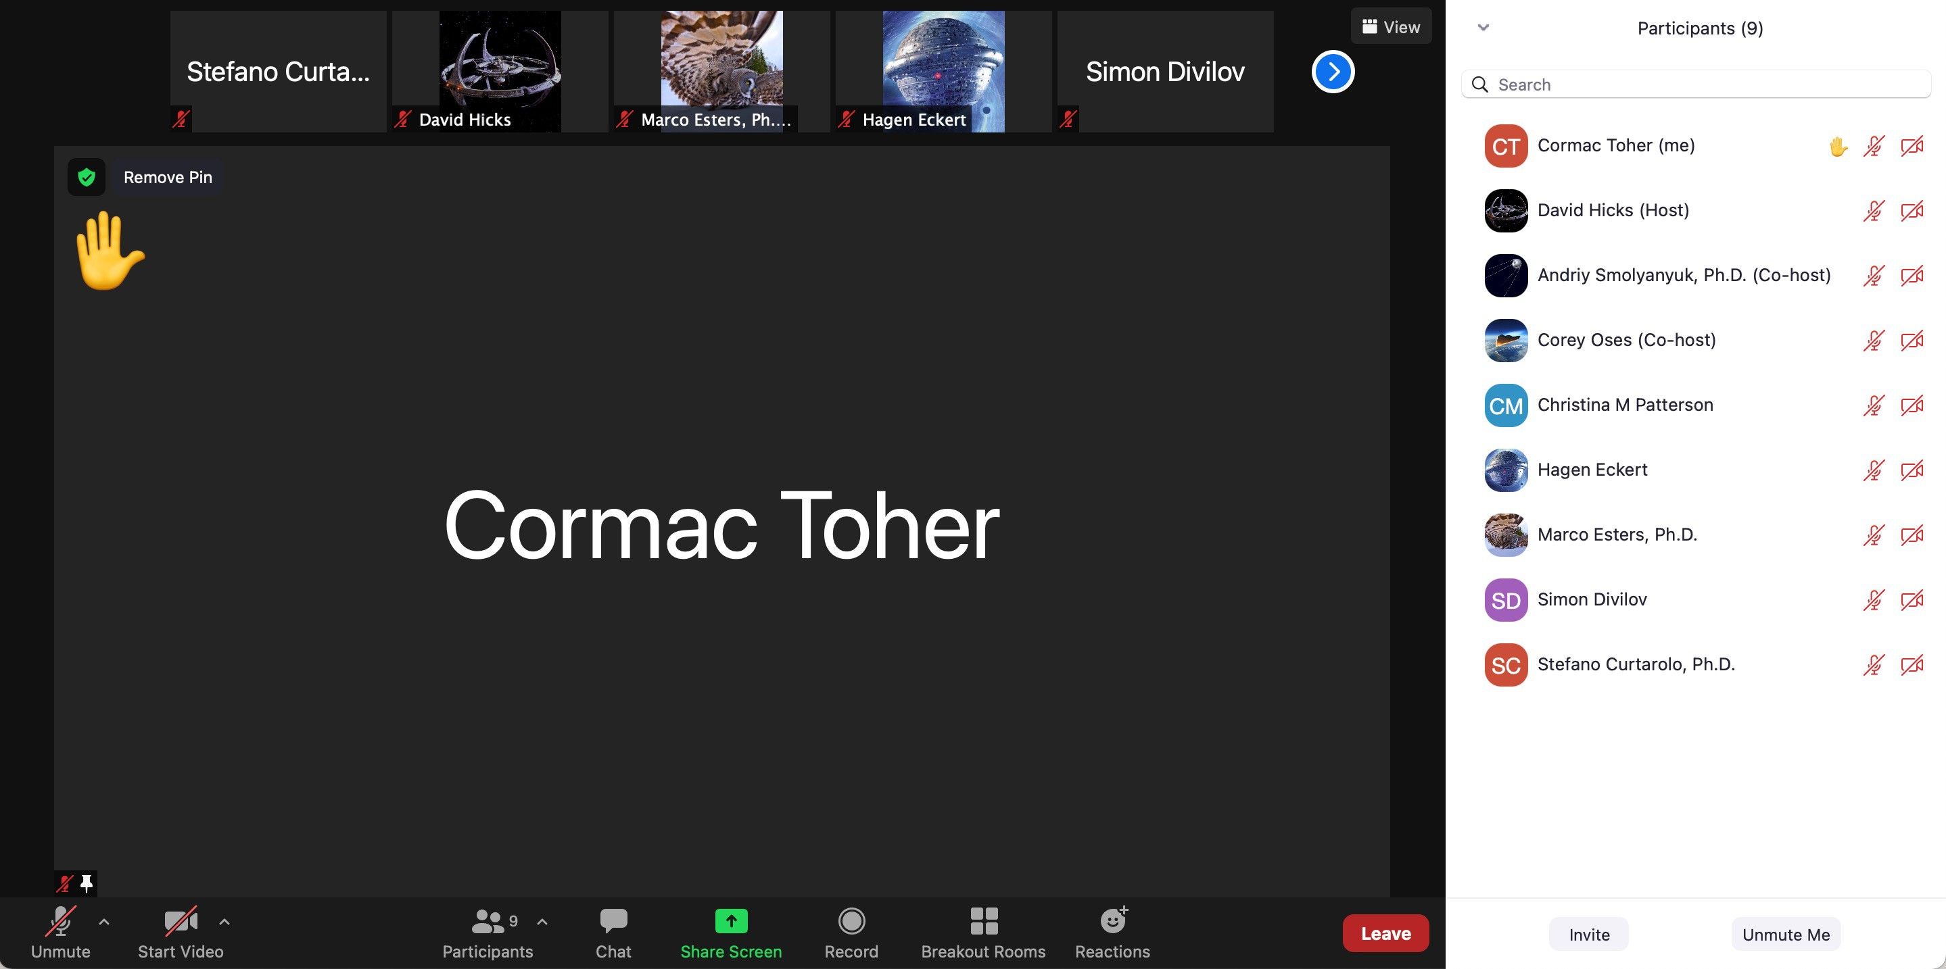
AFLOW School Zoom Logistics
Raised hand button

Slide 6
AFLOW School Zoom Logistics
Exercises will be part of each session
For exercises, group will be separated into breakout rooms within Zoom
One instructor will be in each breakout room, and you can ask this instructor for assistance, share your screen with them, etc.
Exercise materials are available in the TU Dresden VNC portal – to access the portal, you will need to install and run the TU Dresden VPN: https://tu-dresden.de/zih/dienste/service- katalog/arbeitsumgebung/zugang_datennetz/vpn#
Follow instructions for your operating system

Slide 7
AFLOW School Zoom Logistics
Once VPN is connected, log into VNC virtual machine using link and password sent to you by email
Please do not use the “Log out” function, as this will shut down the VM for everyone
Please do not shut down the VM
To exit, simply close the browser window/tab
Please do not change the resolution in the desktop environment

Slide 8

AFLOW School Zoom Logistics
Connect to Virtual Machine

Slide 9

AFLOW School Zoom Logistics
Use password sent to you by email

Slide 10
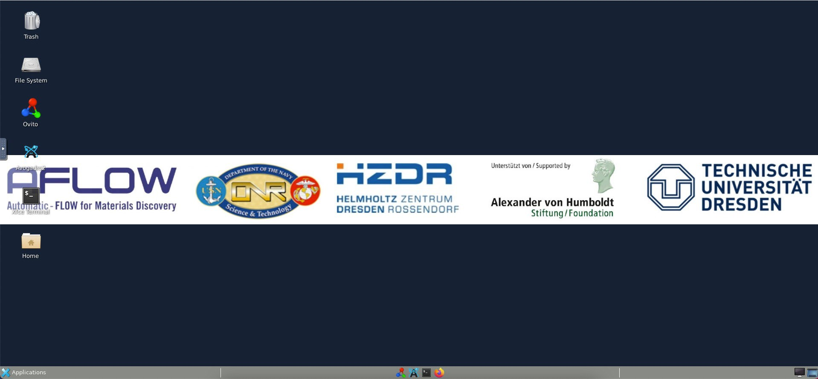
AFLOW School Zoom Logistics
Clipboard and screen resizing

Slide 11
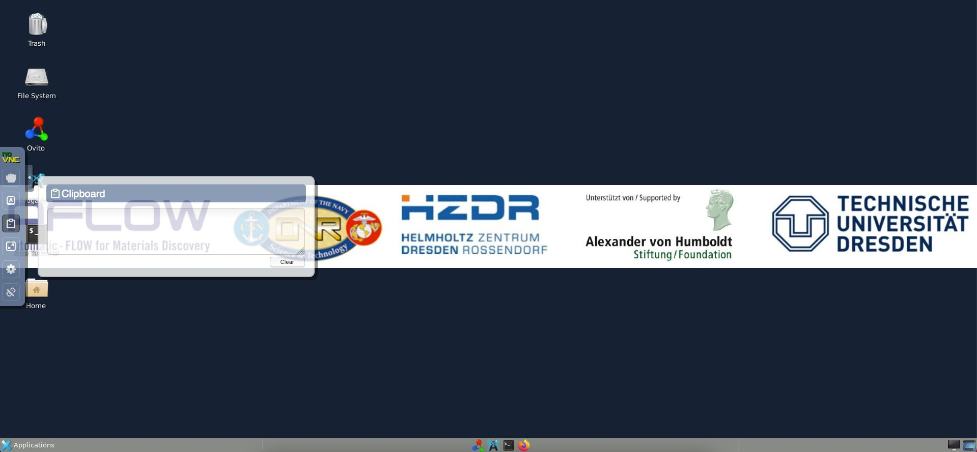
AFLOW School Zoom Logistics
Open clipboard to copy/paste into Portal
Use clipboard to copy/paste into Portal

Slide 12
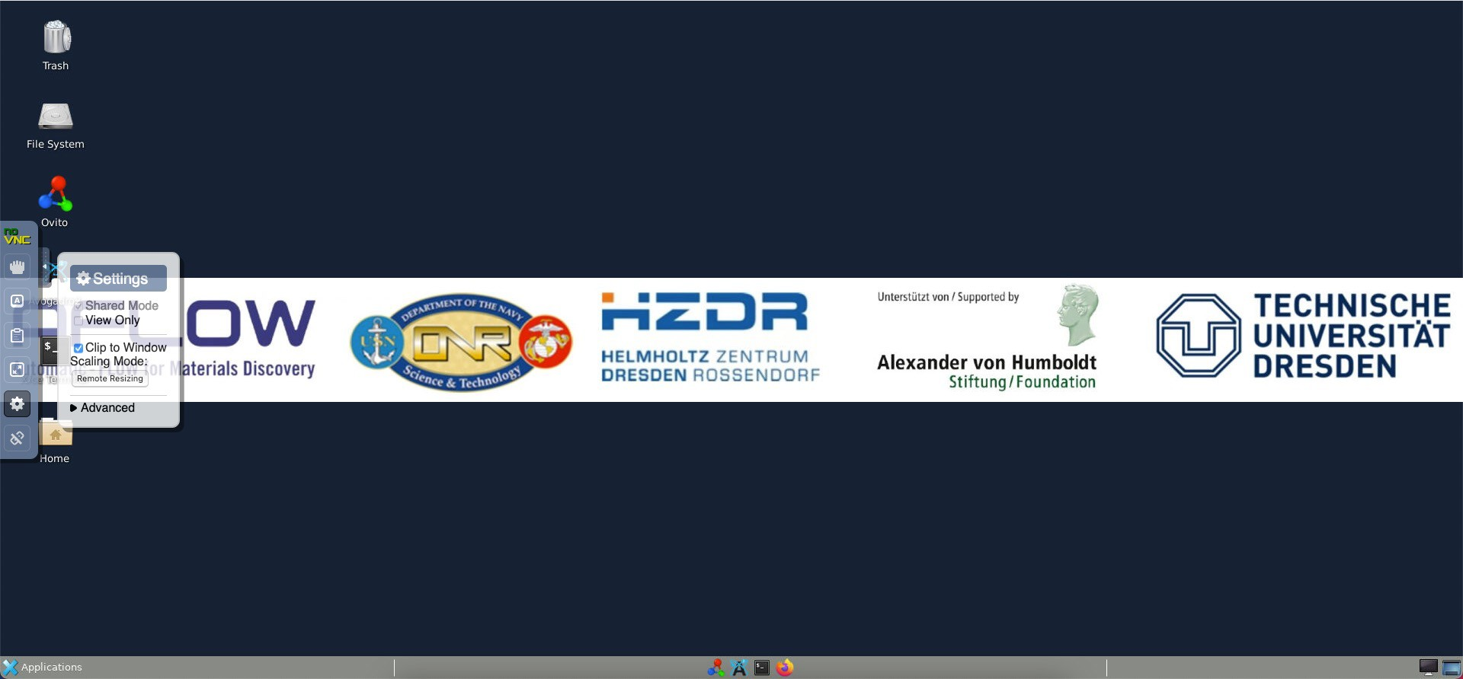
AFLOW School Zoom Logistics
Clip to Window Scaling mode
Remote Resizing
Settings

Slide 13
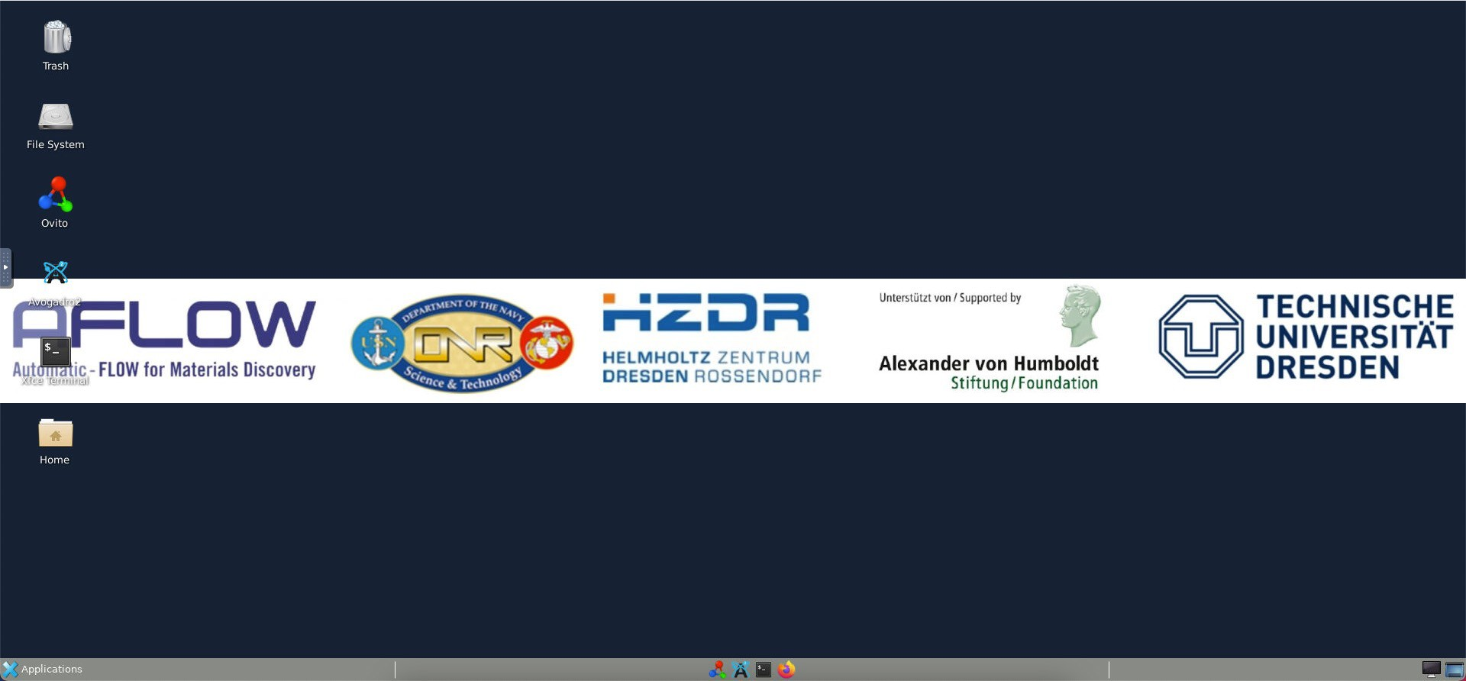
AFLOW School Zoom Logistics
Terminal
Home directory

Slide 14
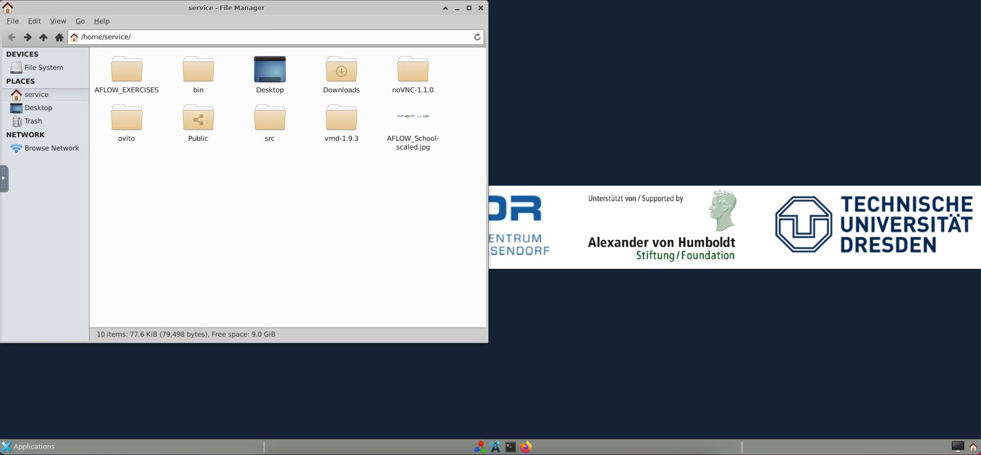
AFLOW School Zoom Logistics
AFLOW Exercises directory

Slide 15
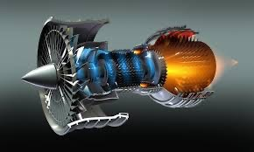
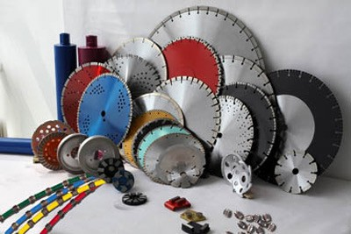
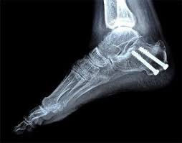
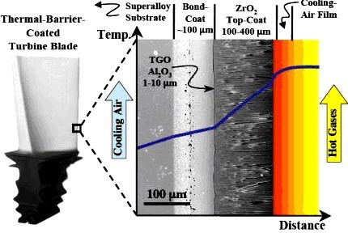
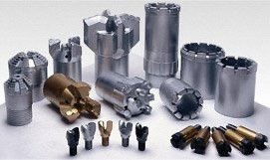

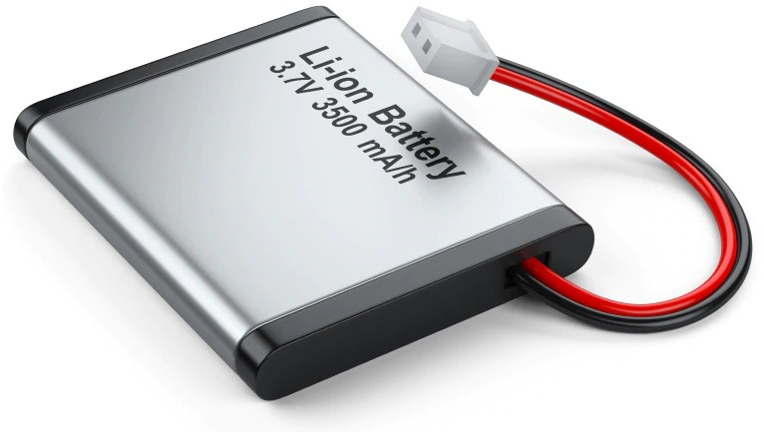
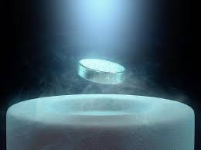
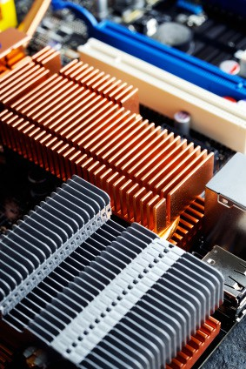
Novel Materials Applications
Biocompatible, corrosion resistant alloys: medical implants
Photovoltaic materials: solar energy harvesting
Thermal barrier coatings: energy/aerospace
Superhard, wear resistant coatings: machine tools
Solid state electrolyte: Li-ion batteries
Superconductors and heat sinks for advanced electronics

Slide 16
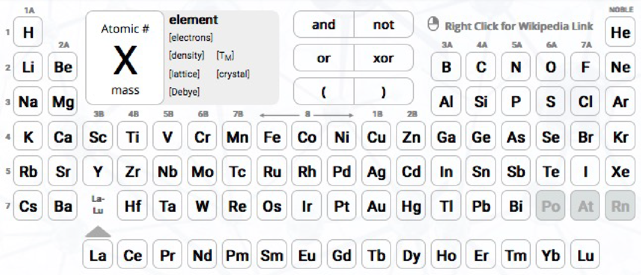
Challenge: materials space
◆
◆
78
78
= 3, 003
= 21, 111, 090
2
5
◆
◆
78
78
= 76, 076
= 256, 851, 595
3
6
◆
78
= 1, 426, 425
4

Slide 17
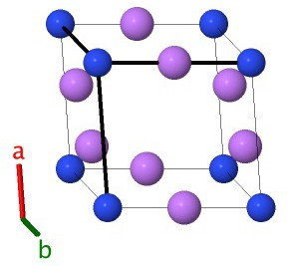
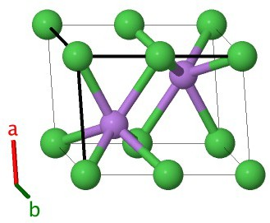
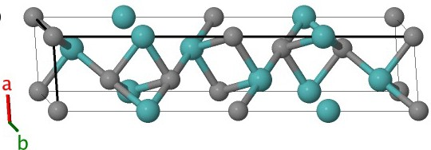
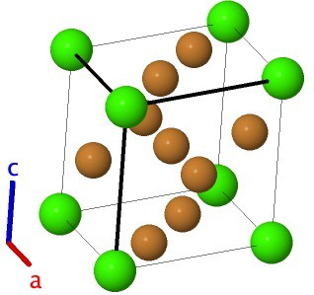
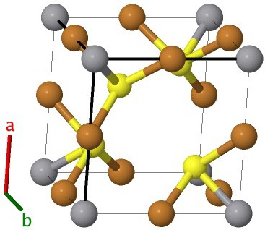
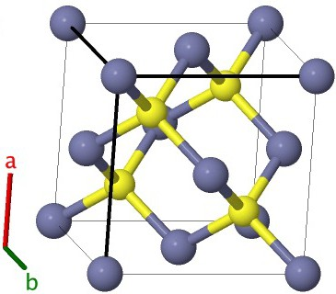
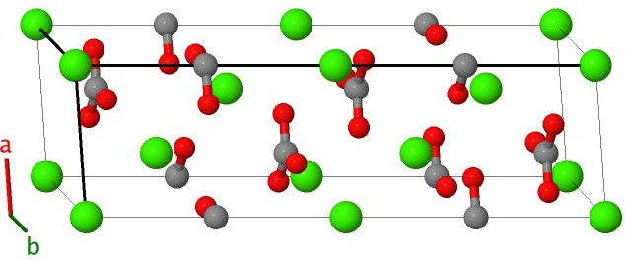
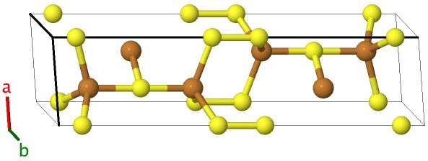
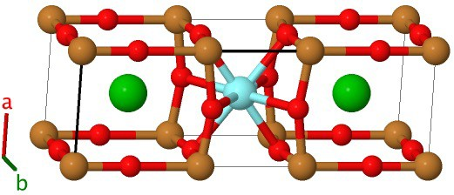
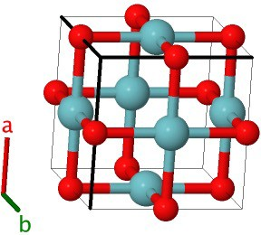
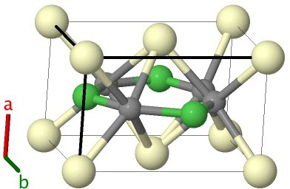
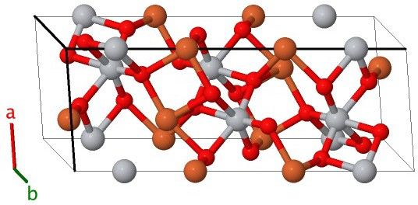
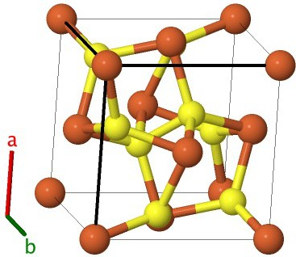
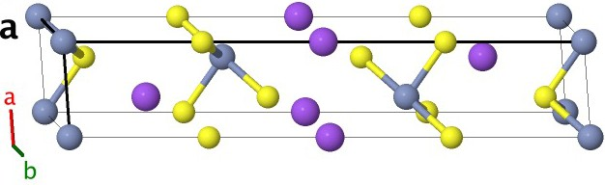
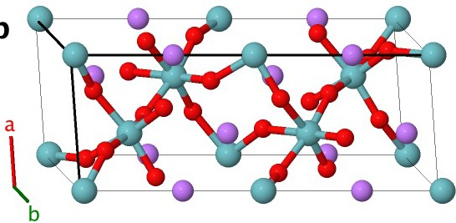
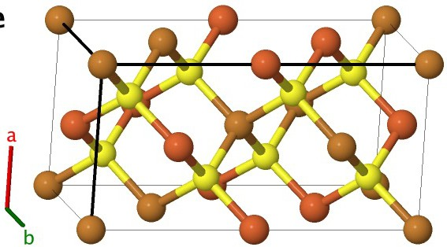
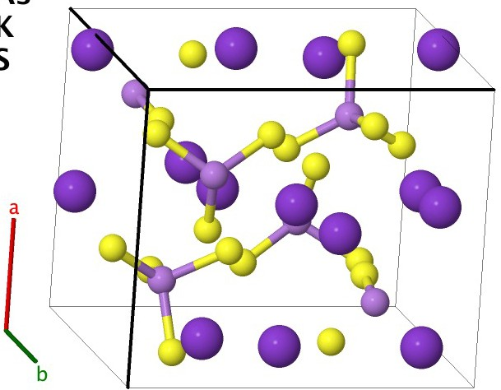
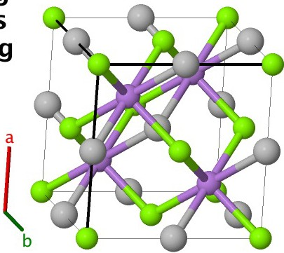
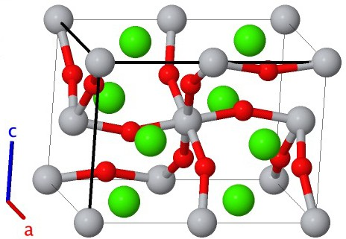
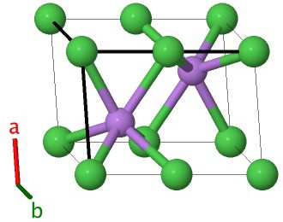
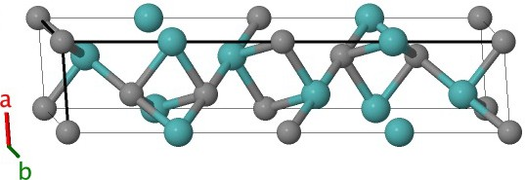

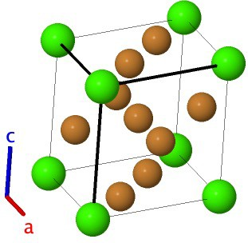
Challenge: materials space
M. J. Mehl et al., Comput. Mater. Sci. 136, S1-S828 (2017), D. Hicks et al., Comput. Mater. Sci. 161, S1-S1011 (2019)

Slide 18
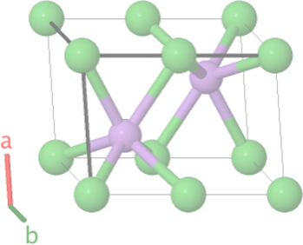
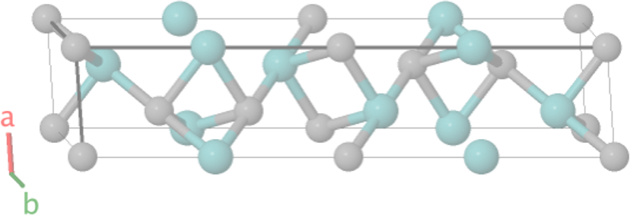
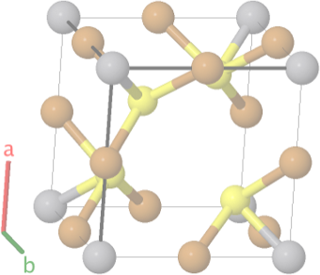















Challenge: materials space
₁₀177
M. J. Mehl et al., Comput. Mater. Sci. 136, S1-S828 (2017), D. Hicks et al., Comput. Mater. Sci. 161, S1-S1011 (2019)

Slide 19



Automated Materials Discovery
Automated computational materials discovery:
Experimental structures Automated QM calculations
Structural prototypes
Density functional theory
Searchable/sortable database
Candidate materials
http://www.aflow.org
ML models
19

Slide 20



AFLOW: Automatic FLOW
Input file generation
aflow.in
AFLOW
DFT-
DFT-
DFT-
Calculation management
code
code
code
ERROR?
DFT-code
Property calculation
Electronic
Thermal
Elastic
AFLOW source code now available under GPL 3 materials.duke.edu/AFLOW/
Database storage
Storage
Curtarolo et al., Comput. Mater. Sci. 58, 218 (2012); Calderon et al., Comput. Mater. Sci. 108A, 233 (2015)

Slide 21


AFLOW.org: web portal
aflow.org
AFLOW
Schools and Seminars
> 700 million properties
> 3.5 million entries
breakdown of properties
Curtarolo et al., Comput. Mater. Sci. 58, 218 (2012); Calderon et al., Comput. Mater. Sci. 108A, 233 (2015)

Slide 22

AFLOW.org: seminars
Seminar sign-up link
Online seminars hosted by Center for Autonomous Materials Design
Seminars take place every two weeks on Thursday afternoons
See aflow.org/seminars/ for more details
22

Slide 23

AFLOW.org: applications
aflow.org
Curtarolo et al., Comput. Mater. Sci. 58, 218 (2012); Calderon et al., Comput. Mater. Sci. 108A, 233 (2015)
23

Slide 24
AFLOW.org: search page
Element group selection
Number of species
Element selection
Logic operations
R. H. Taylor et al., Comput. Mater. Sci. 93, 178-192 (2014)
aflow.org/search/

Slide 25
AFLOW.org: search page
Slide to Property Filters
Bring property filters onto search page
R. H. Taylor et al., Comput. Mater. Sci. 93, 178-192 (2014)
aflow.org/search/

Slide 26

AFLOW.org: search page
Property Filters
R. H. Taylor et al., Comput. Mater. Sci. 93, 178-192 (2014)
aflow.org/search/

Slide 27

AFLOW.org: search page
Selected Elements
Number of species=2
Added filter for Egap: electronic band bap
Check box to restrict search results to specific value range
Select “Add” to add filter
R. H. Taylor et al., Comput. Mater. Sci. 93, 178-192 (2014)
aflow.org/search/

Slide 28
AFLOW.org: search page
Exercises:
Use the advanced search functionality to find the band gap for SiC in the zincblende structure (space group number 216).
Use the advanced search functionality to find the materials containing Sn but not Pb with band gaps between 1 eV and 3 eV in the ICSD catalog of the AFLOW database. How many results are returned?
Alternative server: aflowlib.duke.edu/search/ui/
R. H. Taylor et al., Comput. Mater. Sci. 93, 178-192 (2014), F. Rose et al., Comput. Mater. Sci. 137, 362 (2017)
28

Slide 29














Objective 1: Stability screening
elements + arrangements
0.8
0.6
Zr
0.4 0.2
aflow.org
⁰100
100¹
formation enthalpy (meV/atom)
50
0
≠50
≠100
≠150
≠200
50
0
≠50
≠100
≠150
≠200
CuZr₂
Cu₅Zr
Cu₁₀Zr₇
Cu₂Zr
≠250₀
0.2
0.4
0.6
0.8
₁≠250
Cu
Thermodynamic stability
C. Oses et al., J. Chem. Inf. Model. 58(12), 2477-2490 (2018)
29

Slide 30


Objective 1: Stability screening
elements + arrangements
Mechanical stability

Slide 31




Objective 2: Design rule discovery
Example 1: superconducting critical temperature
O. Isayev, D. Fourches, E. N. Muratov, C. Oses,
K. Rasch, A. Tropsha, and S. Curtarolo, Chem. Mater. 27(3), 735-743 (2014).
T_{C} "
T_{C} #
Mo₆PbS₈
Mo₆NdS₈
Example 2: thermal conductivity in perovskites
A. van Roekeghem, J. Carrete, C. Oses,
S. Curtarolo, and N. Mingo, Phys. Rev. X 6, 041061 (2016).
A
X₃
 / B
 / A
B
ABX₃ [X = F, O]
ABF₃
ABO₃

Slide 32








Objective 3: Machine learning models
Electronic Proper1es
Thermo-Mechanical Proper1es
no E_{BG}
yes
crystal structure
classiﬁca4on model
metal or
i
{X E R}
nsulator?
bulk modulus (VRH)
predic4on
no
regression models
{E_{BG} E R :
E_{BG} > 0}
band gap energy predic4on
regression model

Slide 33
AFLOW: Installation
AFLOW can be used on Linux, Mac, and Windows
Windows requires additional software:
Windows Subsystem for Linux (Windows 10)
Cygwin (other Windows versions)
For instructions and installation scripts, visit:
http://aflow.org/install-aflow/
Curtarolo et al., Comput. Mater. Sci. 58, 218 (2012); Curtarolo et al., Comput. Mater. Sci. 58, 227 (2012)
33

Slide 34
Outline: Day 1
Keynote address: To mix or not to mix? Synthesizability entropy-descriptors and the controversial role of vibrations in the stability of high-entropy ceramics (S. Curtarolo)
Session 1: DFT+AFLOW (C. Oses & D. Hicks)
VASP input files
Energy calculations and k-point convergence
Primitive and conventional cell representations
Spin-polarized calculations
Density of states and band structure calculations
AFLOW input file: aflow.in
Configuration file: aflow.rc
Managing ab-initio calculations

Slide 35
Outline: Day 2
Session 2: Symmetry (D. Hicks)
AFLOW-SYM algorithm
AFLOW-SYM output files
AFLOW-SYM command line interface
AFLOW-SYM Python wrapper
Brillouin zone and AFLOW Standard k-path
AFLOW-SYM via AFLOW-Online
Session 3: Structure prototyping (D. Hicks)
Resolving material/structural prototypes
AFLOW Crystal Prototypes (encyclopedia)
AFLOW prototype generation

Slide 36
Outline: Day 3
Session 4: Thermodynamic stability (C. Oses)
Identifying stable vs. unstable structures
Applications: Rare-earth free Heusler magnets
AFLOW-CHULL
Session 5: Thermodynamics of polar materials (R. Friedrich)
Thermodynamic stability of polar materials: CCE
Application: Thermodynamic stability of ternary oxides and halides
AFLOW-CCE
Session 6: Disorder (C. Oses)
Resolving material/structural prototypes
AFLOW-POCC: Ensemble average properties
AFLOW-POCC algorithm
AFLOW-POCC via AFLOW-Online
AFLOW-POCC command line interface

Slide 37
Outline: Day 4
Session 7: Thermomechanical properties (C. Toher)
AFLOW-AEL: Elastic properties
AFLOW-AGL: Debye model
Session 8: AFLOW.org database and APIs (M. Esters)
AFLOW.org database structure
AFLOW REST-API
AFLUX: AFLOW Search API
Session 9: Machine Learning (C. Toher)
PLMF representation
AFLOW-ML API

Slide 38
Outline: Day 5
Session 10: AFLOW-XtalFinder (D. Hicks)
AFLOW-Xtalfinder algorithm
AFLOW-Xtalfinder command line interface
AFLOW-Xtalfinder Python wrapper
Session 11: Phonons in the Harmonic Approximation (M. Esters)
Introduction to phonons
AFLOW-APL: Phonon dispersions and phonon DOS
AFLOW-APL: Thermodynamic properties from phonons
AFLOW-APL: Visualizing atomic displacements
Session 12: The Quasi-Harmonic Approximation (A. Smolyanyuk)
Introduction to the quasi-harmonic approximation
AFLOW-QHA: Calculating and visualizing thermodynamic properties

